Slide 1
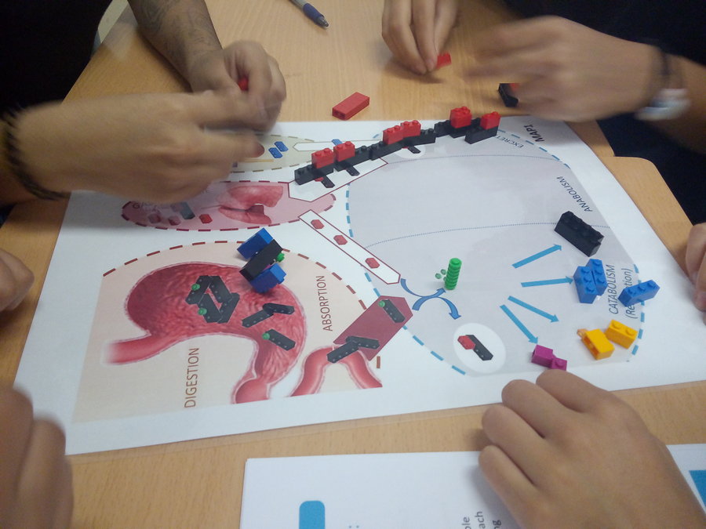
1.Preparing the Materials
2.Depeloping the activity
3.Key Ideas an Further developments
4.Credits, Licenses and Contact
LIFE BRICKS 2.1
Didactic Guide
This card is part of the materials of the activity “LifeBricks” Materials of the activity and Didactic Guides are available for its download at: https://bit.ly/2ZksPOp

Slide 2
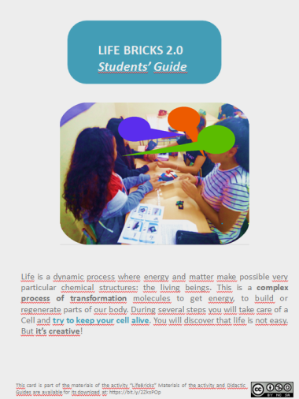
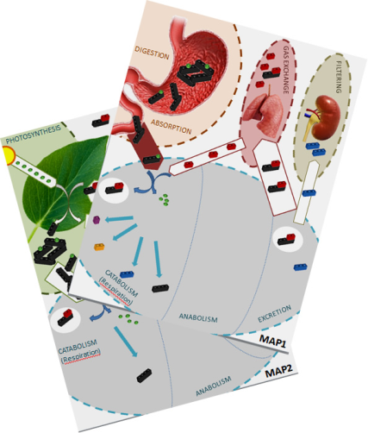
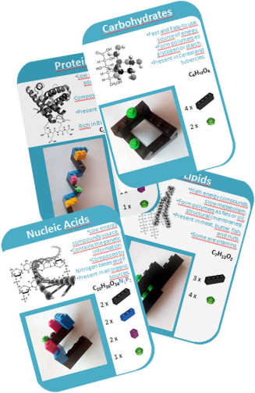
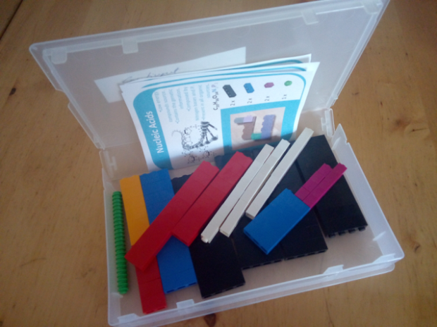
1.Preparing the materials (1)
LIFE BRICKS
To develop the activity, you have to prepare a LifeBricks Kit for each team (3-4 students per team). This include:
Printable materials (available to download at https://bit.ly/36TfJIL
Students’ Guide Instructions for students. You can use it with your students in printed or digital format | LifeBricksMaps (print in A3 and plasticize as playboards) | LifeBricksCards Cards to print and plasticize to distribute together with Lego pieces
Lego pieces.
A set of 157 different Lego pieces are needed for each team. A descripcion of the pieces needed is available at the next page. To stock the materials as kits (toghether with the LifeBricksLabels students have to use as a reference), I’ve used old VHS video covers, as you can see in the photo One kit (pieces to build 3 biomolecules of each kind) can easily fit in one video cover. It’s useful to give each video cover an identification number and ask students to make an inventory of pieces before and after the activity. LifeBricksCards document provide specific cards for it. Lego pieces get easily lost, so it’s a good idea to have additional pieces to replace it.

Slide 3
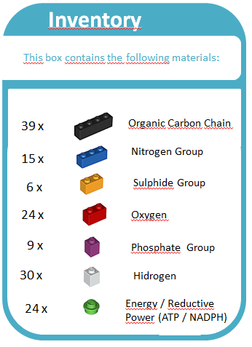
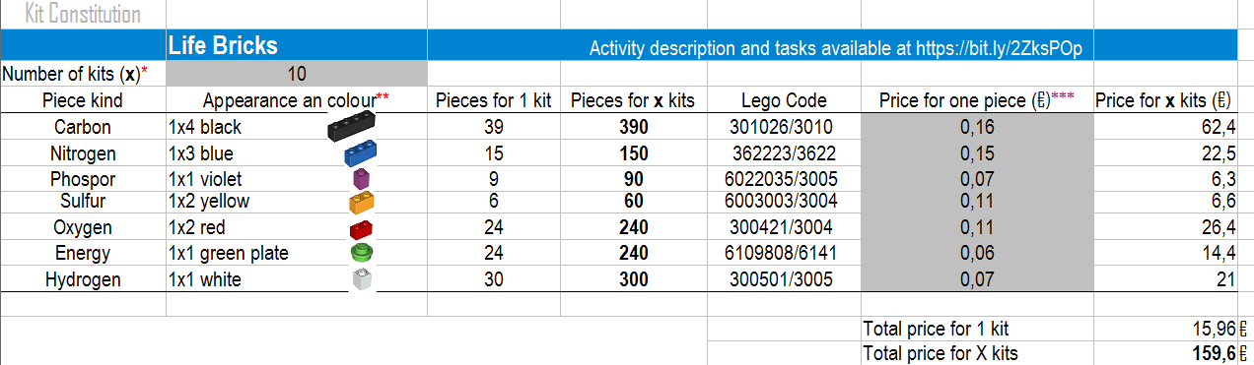
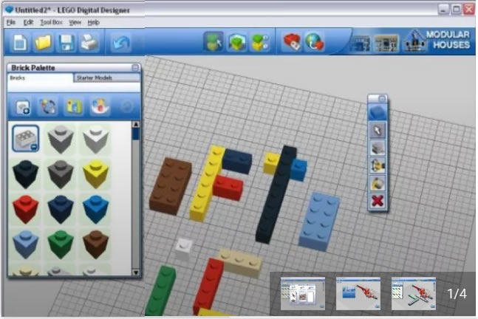
1.Preparing the materials (2)
LIFE BRICKS
You can buy lego specific bricks through the Lego site, where you can find also the codes for each different brick. https://www.lego.com/es-es/page/static/pick-a-brick
I’ve built the KitConstitution document specifying the number of pieces, codes of each piece to build a whole kit, in a way that allows you to calculate the total number of each piece and the total price for a given number of kits, and furnish the Lego piece codes to buy it. It’s available to download at https://bit.ly/34EvPUS
Virtual Blocking
If you prefer not to buy Lego Pieces, you can also develop the activity in the Lego Digital Designer program, Free to download at:
https://lego-digital-designer.en.softonic.com/
Please note that the download site is not the Lego site, as Lego has discontinuated the updates. Be careful when downloading not to click on additional downloads from softonic.
Anyway, I’d advice you to develop paper “touchable” pieces rather than use virtual Lego, as it implies two symbolization steps (Lego and virtual).

Slide 4
2.Developing the activity
The activity is composed by 5 Modules. First of all (Module 0), give to students (in teams of 3-4) the materials (Lego pieces, Cards and Maps) and make them familiar with the materials and Pieces. Get with them agreements to make possible that at the end of the activity students collect and store all the pieces. Discuss with them the meaning of each piece or organic biomolecule.
From this point, follow each of the Modules 1,2,3,4 in the proposed order, as in the Students’ Guide. Each activity deal with some key ideas written on the bottom of each activity proposal. Make sure students understand the key of an activity prior to begin the next activity. To this end:
1) Ask them to get a consensus to complete the questions (What we do, What happened , What does it mean...).
2) Make a general dialogue with the whole group between Modules.
In Module 1 students are asked to build biomolecules from previously catabolized biomolecules, and they will observe a global loss of carbon as carbon dioxyde, so they can’t build the same number of biomolecules.
In Module 2 each team represent to be a different kind of cell, thus having different priorities when trying to build biomolecules. As a result, each team will experience different metabolic difficulties (lack of energy, excess of N), and students will discover that cells can exchange products to overcome some of these difficulties (make sure that at the end of the class, each box have the correct number of pieces).
In Module 3 each team represent again a “standard” cell, but each of them have a different diet. Again, this will result in metabolic difficulties, different for each diet. It’s important to underline during the discussion the role of essential elements and total energy for a diet.
In Module 4, students use a different map to reproduce a Photosynthesis process. There is a step when “night” mode is activated, so the plant gets energy only by catabolising the carbon chains synthesised during photosynthesis in the “light” mode. Make sure students understand that the main differences of plants are the source of carbon chains (photosynthesis instead of organic matter from other living beings) and the source of essential bioelements (soil and roots instead of organic matter from other living beings).

Slide 5
3.Key ideas and further depelopment (1)
During the activity, some conceptual simplifications are used.
Energy (ATP) and “Reductive Power” (NADH or FADH) are both represented by the same green “Energy” piece and situated on a black Carbon Chain piece. “Energy” pieces can be obtained by de-building organic biomolecules, and resulting in Oxidized Carbon Chains (substituting green “Energy” pieces by red Oxigen Pieces), representing Catabolism. Oxidation of other compounds is not considered in this simulation.
Oxidized Carbon Chains can be rescued by consuming “Energy” pieces , this representing the reductive nature of the “Energy” pieces and the anabolic “Gluconeogenesis” metabolic pathway.
The different kinds of biomolecules are represented by different ratios of Carbon Chains, energy and Bioelements. Carbon chains are represented by black short pieces to make it easier to build the molecules. Hydrogen white pieces are not used in the current designed activity, the black pieces represent reduced Hydrogen-Carbon Chains as a whole. The biochemical behaviour of the resulting biomolecules is not exact, but some differences have been set between different kinds: 1) Both Carbohydrates and Lipids are formed by Carbon Chains and Energy, but Lipids catabolism will result in higher levels of energy and Carbon oxidation (Carbohydrates are more useful for Anabolism). Both Proteins and Nucleic Acids have lower “Energy” content, but Proteins contain a richest diversity of bioelements. This has been done to reproduce the different needs for the anabolism of different biomolecules (it is not possible to build Proteins or Nucleic Acids strictly from Carbohydrates or Lipids). Carbon dioxide (black and red assembling) and nitrogen (blue pices) are toxic products that have to be driven to the excretion zones (lungs and kidney).
Make attention to some possible misconceptions that the activity can promote:
-The activity is ambiguous in relation to the identity of biomolecules or bioelements with atoms. For example, black pieces represent a Chain of unspecific number of Carbon and Hydrogen atoms.
-The activity implies a structural homogenization, as reduces biomolecules to 4 types as standards with no hybrid natures. This is a simplification that have to be addressed. For example, students could understand that all the proteins are identical, or that proteins and lipids have similar sizes, or that there are not hybrid biomolecules (glucolipids…).

Slide 6
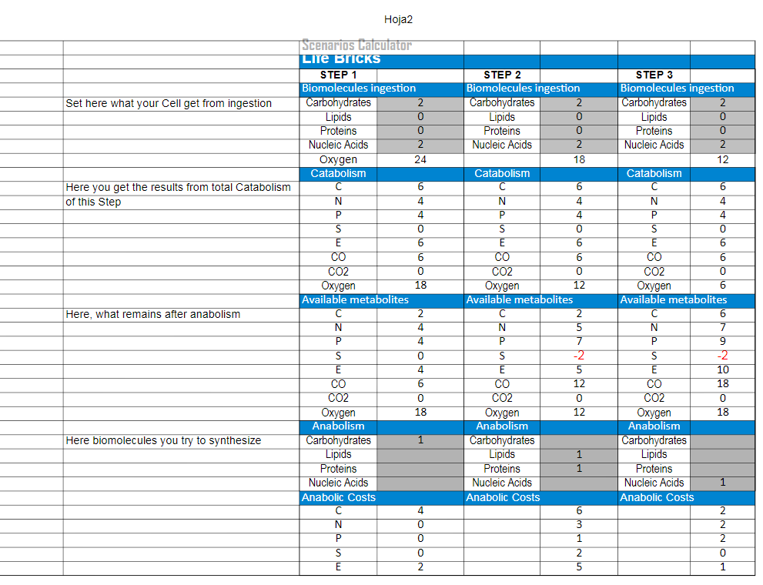
3.Key ideas and further depelopment (2)
Further development
Some metabolic dynamics could be developed, as metabolic diseases, respiration rates, fermentation,... The bricks can be used also for organic chemistry and inorganic chemistry activities, interpreting each brick as an atom and not a group, following the CPK convention colours for molecular modelling. Brick sizes have been set also to allow this Inorganic Chemistry application of the materials, reproducing the main valences (4 for Carbon atoms, 2 for Oxygen and Sulfur, 3 for Nitrogen, 1 for Hydrogen). Some examples of possible “ChemBricks” cards are available together with the rest of the materials.
You might want to develop other Activities with the materials. It’s important to calculate previously if the proposals will be feasible in terms of available carbon chains, energy and essential bioelements. You will find an Excel file “Scenarios Calculations” designed to calculate the possible metabolic scenarios when you change the initial conditions, and the need of pieces for each proposal. Available here: https://bit.ly/2K7MHLR

Slide 7
4.Credits, Licenses and Contact
Credits and Contact
This activity has been developed by Jordi Domènech @jdomenechca jdomen44@xtec.cat , Secondary Education teacher at Institut Marta Estrada (Granollers, Barcelona, Spain).
The original version of this activity has been built at #betacamp19 and further developed.
All the materials are available to download at: https://app.box.com/s/vtmek8dyqfpp8ynat0thsqq9f6g46bi4
License
These materials are shared under a Creative Commons License by-nc-sa 4.0.
You are free to Share and Adapt under the following terms: Attribution, Non Commercial Uses, Share Alike.
Images from Lego pieces, Maps or informatic programs are not under this general License and could have their own License.
This is a Third-Version (2.1) of the activity. The activity has been tested and you are welcome to participate and send your modifications/additions ( jdomen44@xtec.cat ) that if you agree I could eventually add to the materials citing you.

